Slide 1
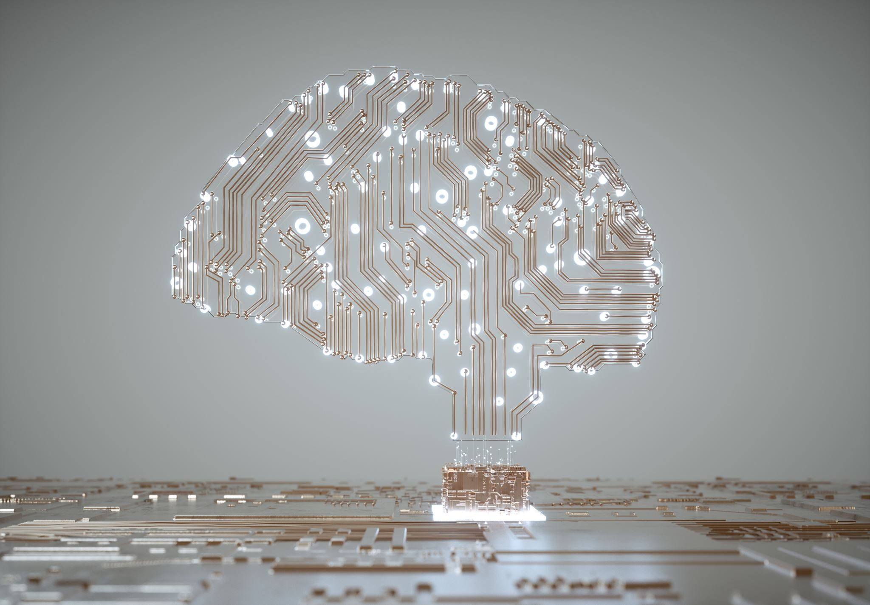

Deep Learning
CIFAR- 10 Dataset
Group Members-
Pankaj
Palash
Shreya
Sunil
Jeevan
Instructor
Babatunde Giwa

Slide 2
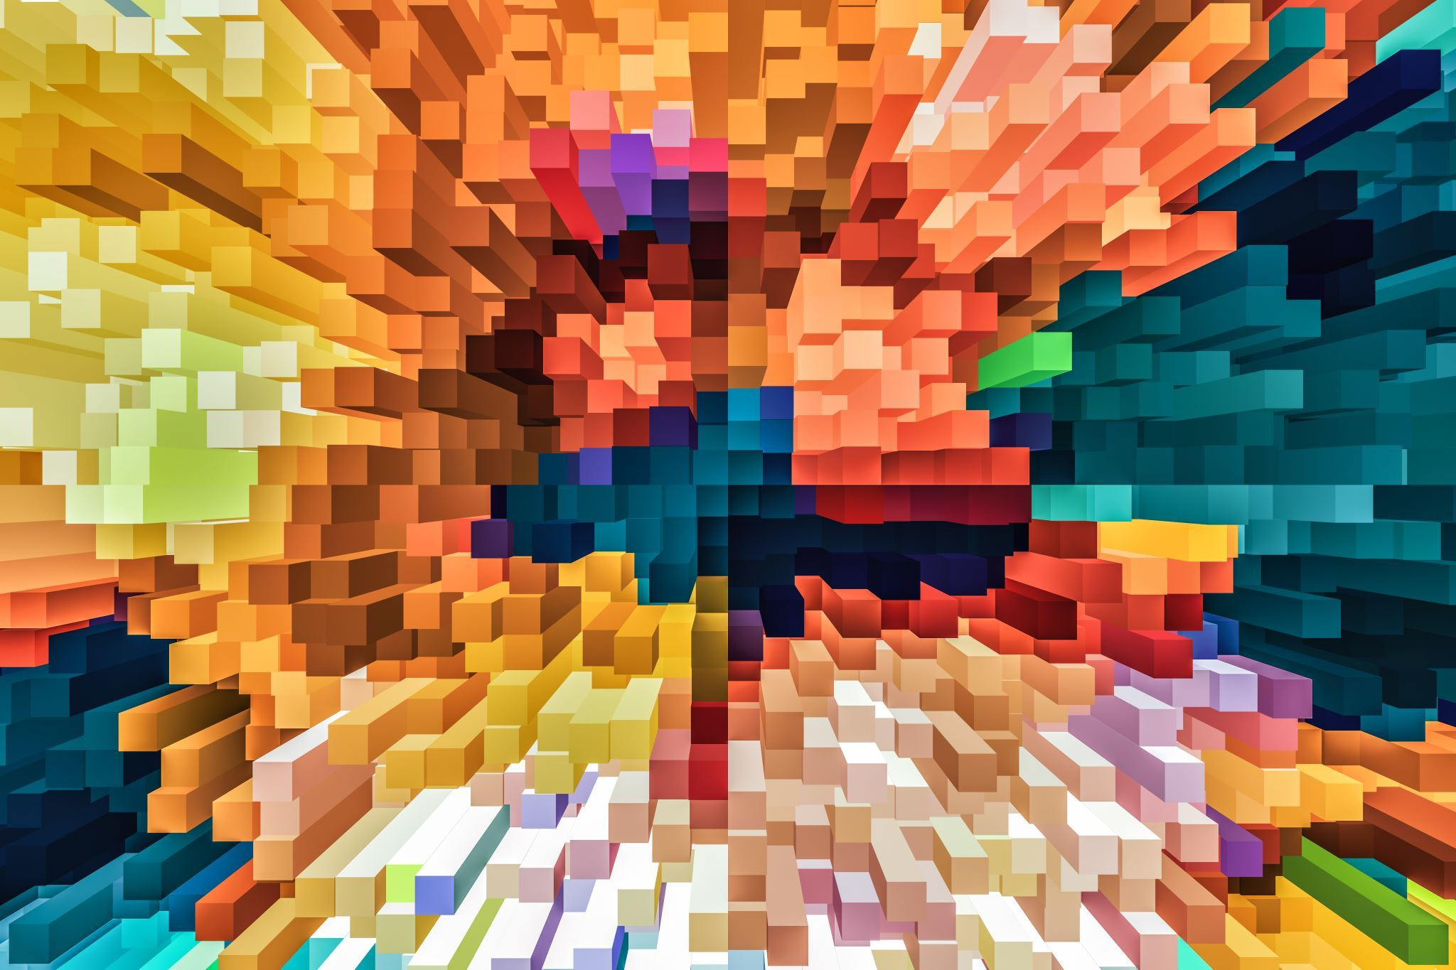
Di
CIFAR-10 dataset consists of 60000 32x32 color images in 10 classes, 6000 images per class
50000 training images and 10000 test images
dataset is divided into five training batches and one test batch, each with 10000 images
test batch contains exactly 1000 randomly-selected images from each class.

Slide 3

Libraries used
TensorFlow
Sklearn
OS
Matplotlyb
Seaborn
Pickle
NumPy
Keras
Itertools
This Photo by Unknown author is licensed under CC BY-NC.

Slide 4
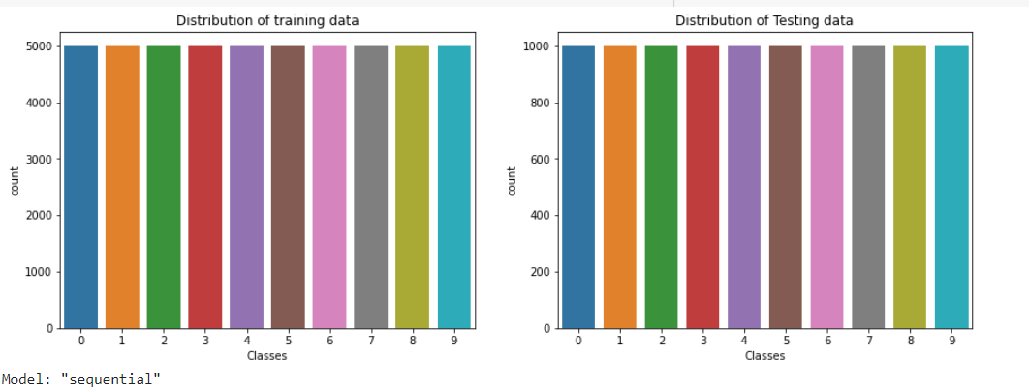
Distribution of data

Slide 5
Architecture’s used
There are 4 different architecture used. They are
MODEL | HIDDEN LAYERS | LEARNING RATE | DROPOUT
MODEL 1 | 4 | 0.001 | 0.25
MODEL 2 | 5 | 0.0001 | 0.3
MODEL 3 | 4 | 0.0001 | 0.2
MODEL 4 | 4 | 0.0001 | 0.15

Slide 6
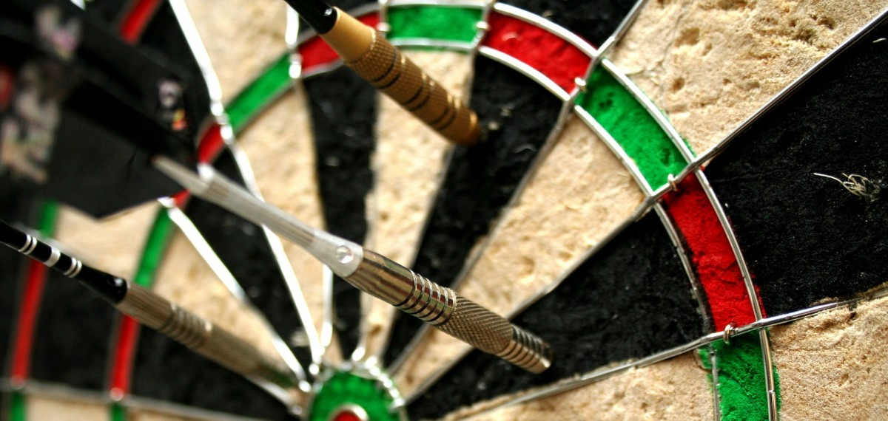
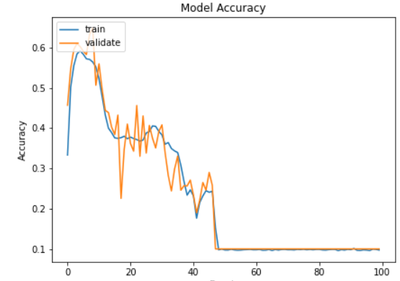
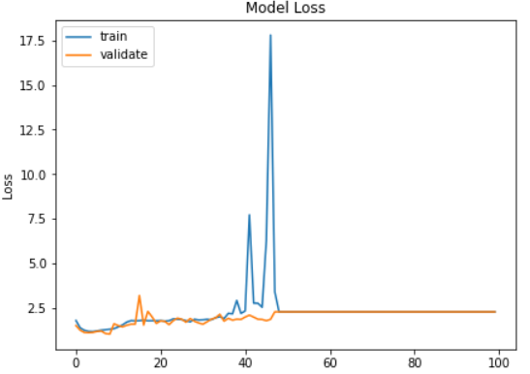
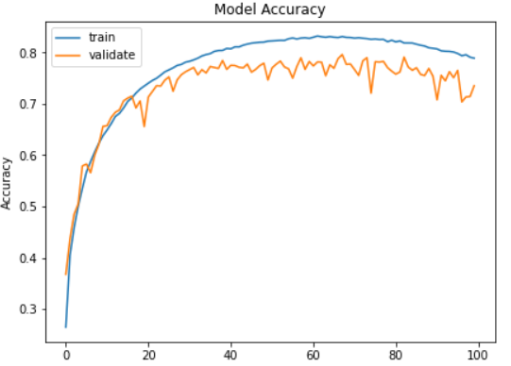
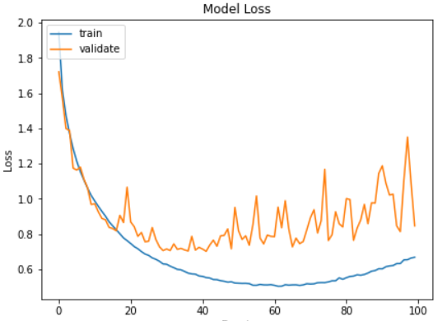
Accuracy

Slide 7
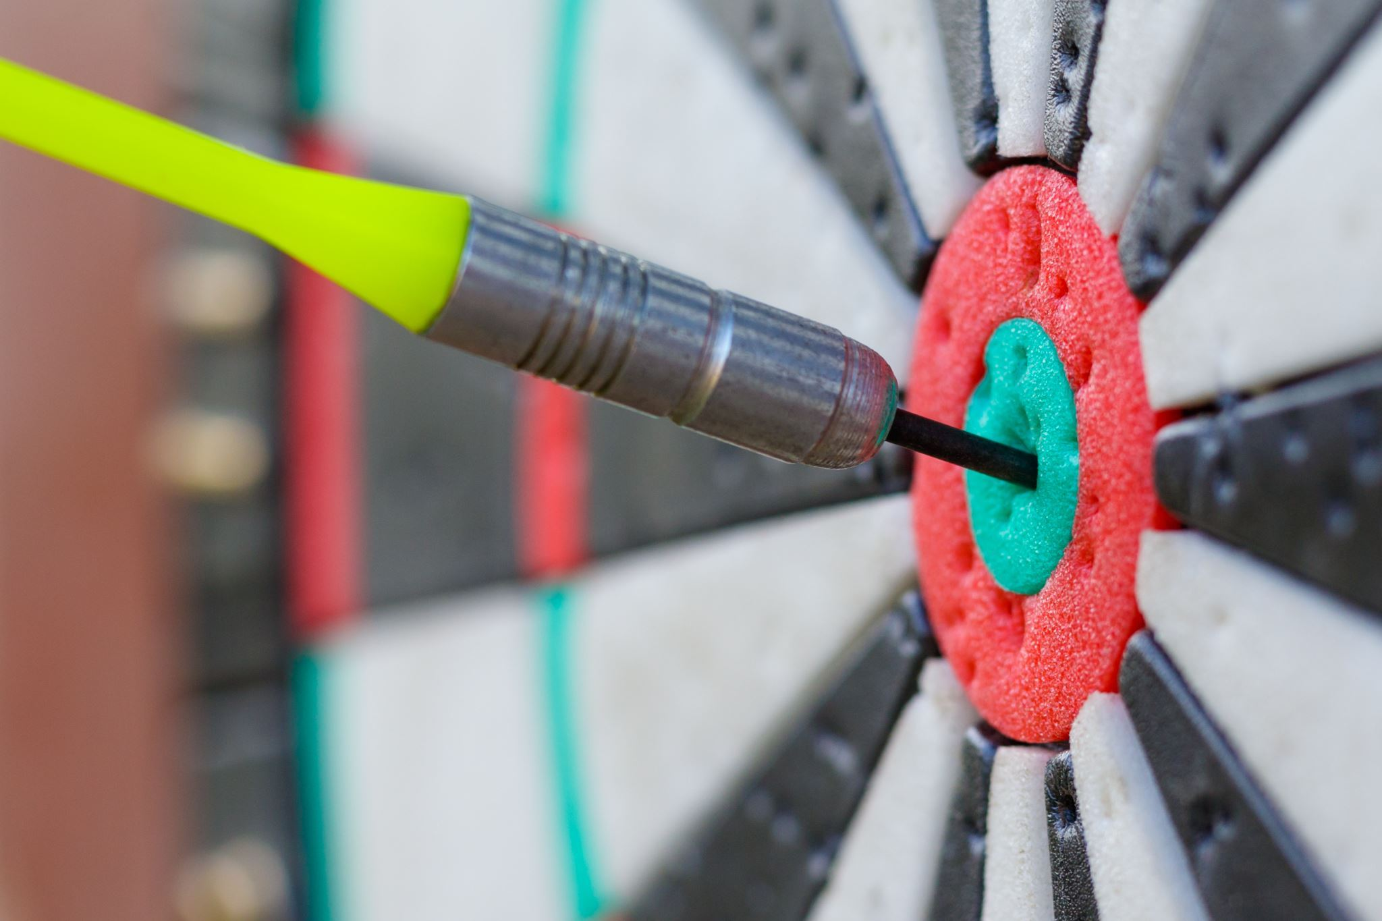
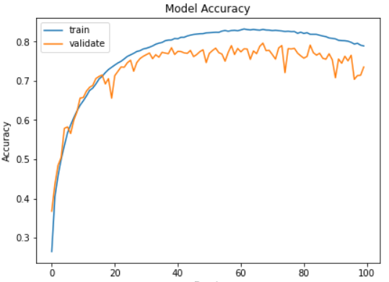
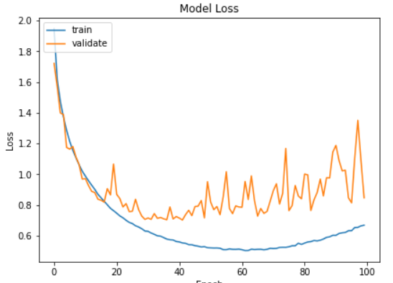
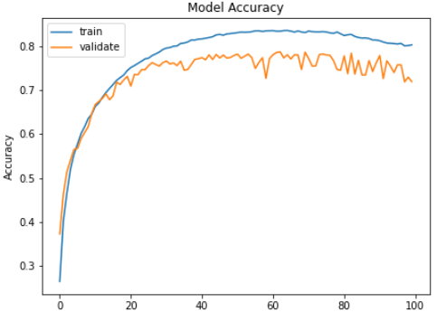
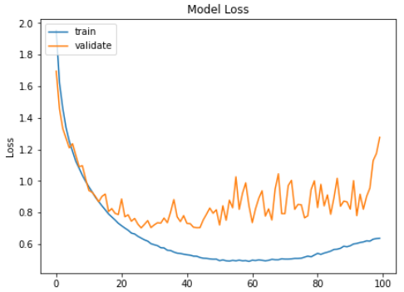
Accuracy

Slide 8
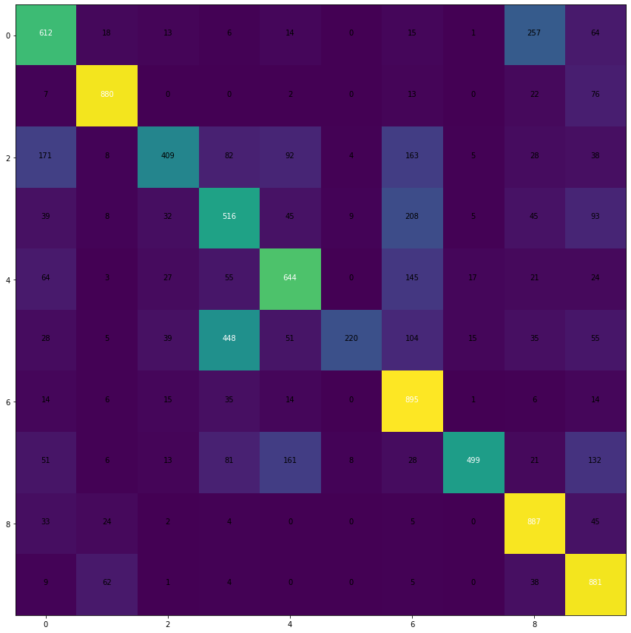
Heat maps

Slide 9
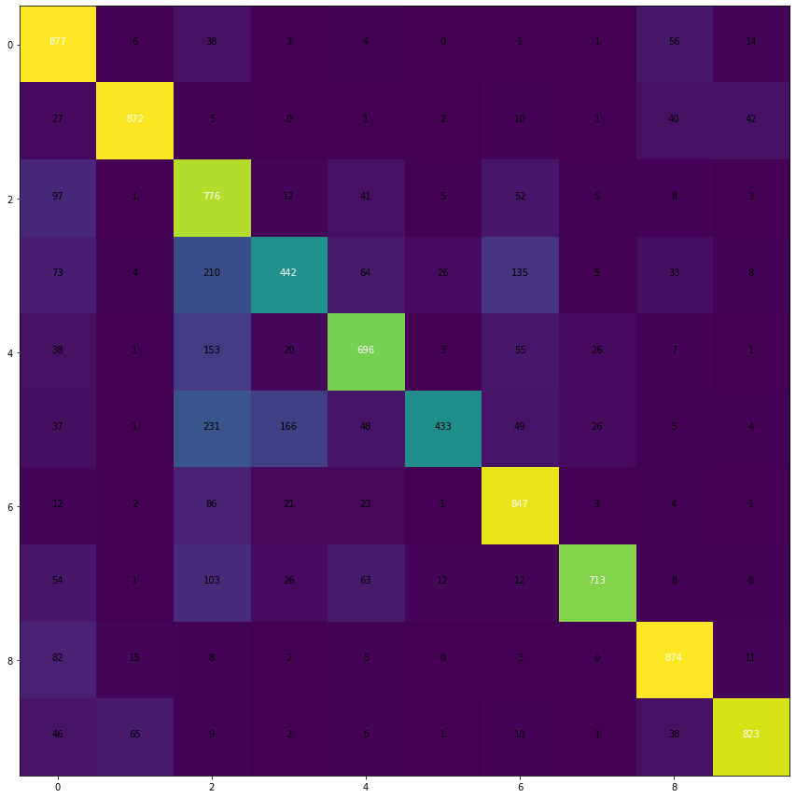
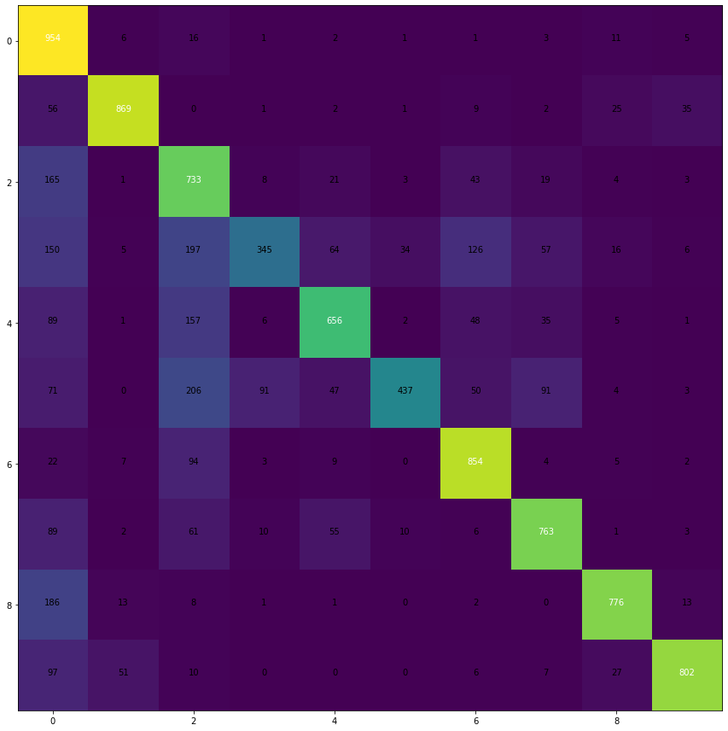
Heat maps

Slide 10

analysis
Accuracy | Architecture1 | Architecture 2 | Architecture 3 | Architecture4
Training Data | 0.0972 | 0.7027 | 0.6443 | 0.8024
Testing Data | 0.1000 | 0.6442 | 0.7353 | 0.7189
Loss | 2.30261 | 1.1481 | 0.8461 | 1.2768
Training Data | 2.3028 | 0.9607 | 1.1482 | 0.6337
Testing Data | 2.3026 | 1.1481 | 0.8461 | 1.2768

